Slide 1
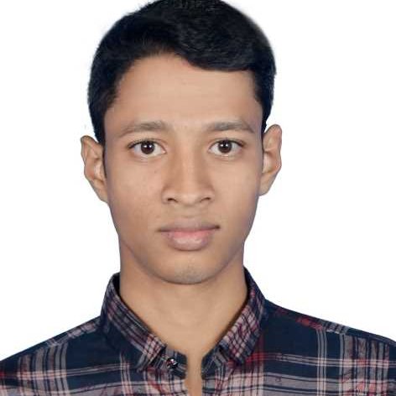








WORK EXPERIENCE
JOB POSITION HERE
COMPANY NAME
Seeking innovation and challenging career in a growing organization which gives me an opportunity to utilize my skills & knowledge and provides me an opportunity for career growth.
PROSENJIT MONDOL
PROSENJIT MONDOL
GRAPHIC DESIGNER
PROFILE
Seeking innovation and challenging career in a growing organization.
CONTACT
CONTACT
ug2102049@cse.pstu.ac.bd
EDUCATION
01315-747034
Starting B.Sc. Engg. in CSE from 2022
Intermediate C.E.C from NGC in 2021
SSC from Chakatitha High School in 2019
SKILLS
Proficiency skills
Office
Photoshop
Personal skills
REFERENCE
Team work
Creativity

